Slide 1
Predicting Forex Trends: A Comparative Study of Probabilistic Graphical Models and Beyond
Sinan He, Qingzhe Guo, Ziming Cui

Slide 2
Predicting Forex Trend
Introduction and Motivation
Approach and Rationale
with Results and Analysis
HMMs
GMM-HMMs
LSTM
XGBoost
Conclusion and future work

Slide 3
Introduction
Foreign exchange (Forex) is the global market for trading currencies, operating 24 hours a day, 5 days a week
Importance of Forex market in global economy. Need for accurate prediction of Forex trends for various stakeholders,including traders, financial institutions, and policy-makers.
Forex trends sensitive to various factors
Impact on international students and individuals affected by currency fluctuations

Slide 4
More Importance of Accurate Forex Trend Prediction
Facilitates international trade
Provides investment opportunities
Determines exchange rates
Enables risk management
Influences central bank policy
Supports tourism and remittances
……

Slide 5

Research Objective and Success Criteria
Goal:
Examine PGMs for predicting medium-term Forex trends. Investigate capabilities of HMMs and GMM-HMMs
Performance comparison of PGMS, LSTM and XGBoost for predicting medium-term foreign exchange trends
Success Criteria
Accurate and reliable models for predicting medium-term Forex trends
Performance metrics: MAE, RMSE, and values
Identify the most suitable approach for predicting Forex trends

Slide 6
Approach and Rationale
Focus on PGMs for compact representation and efficient inference and learning
Implement HMMs, GMM-HMMs, and compare with LSTM and XGBoost
Limit scope: medium-term trends, major currency pairs (CNY/USD, EUR/USD, and USD/JPY), historical price data only

Slide 7
Approach and Rationale
Evaluation Metrics:
Mean Absolute Error (MAE): average magnitude of errors, lower value indicates better accuracy
Root Mean Squared Error (RMSE): square of prediction errors, lower value indicates better performance, sensitive to large discrepancies
R-squared (R2) value: proportion of variance explained, value close to 1 indicates effective explanation of variation in data
Data Collection and Processing
Use Alpha Vantage API for historical price data
Currency pairs: USD/EUR, USD/CNY, and USD/JPY
Data coverage: 5 years, includes open, high, low, and close prices
Preprocessing: cleaning, normalizing, feature extraction
Training and testing datasets: 9:1 ratio
Models: HMMs, GMM-HMMs, LSTM, and XGBoost for Forex trend prediction

Slide 8
Hidden Markov Models
Stochastic processes with hidden and observable states
Applications: speech recognition, NLP, and financial market predictions
Main Components of HMMs
Hidden states
Observations
State transition probability matrix
Observation probability matrix
Initial state probability distribution

Slide 9
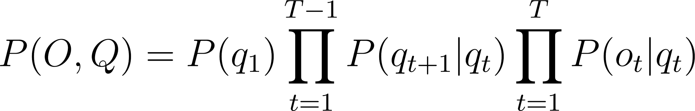
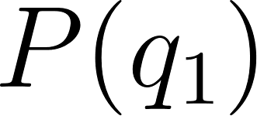
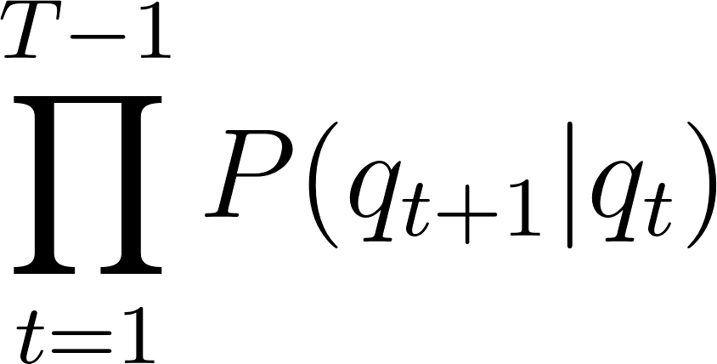
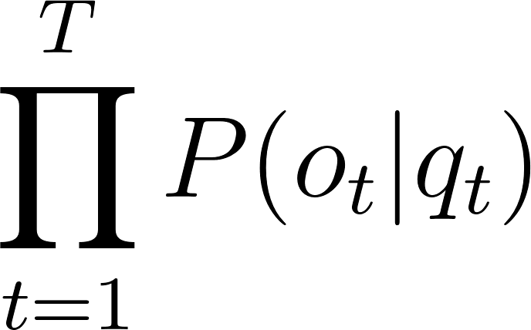
Hidden Markov Models
Joint Probability distribution:
Three main components
: The initial probability distribution of the hidden states at the beginning of the process (time step 1).
: The product of the state transition probabilities, representing the probability of transitioning from one hidden state to another across time steps.
: The product of the observation probabilities, representing the probability of observing a particular state at each time step given the hidden state.

Slide 10
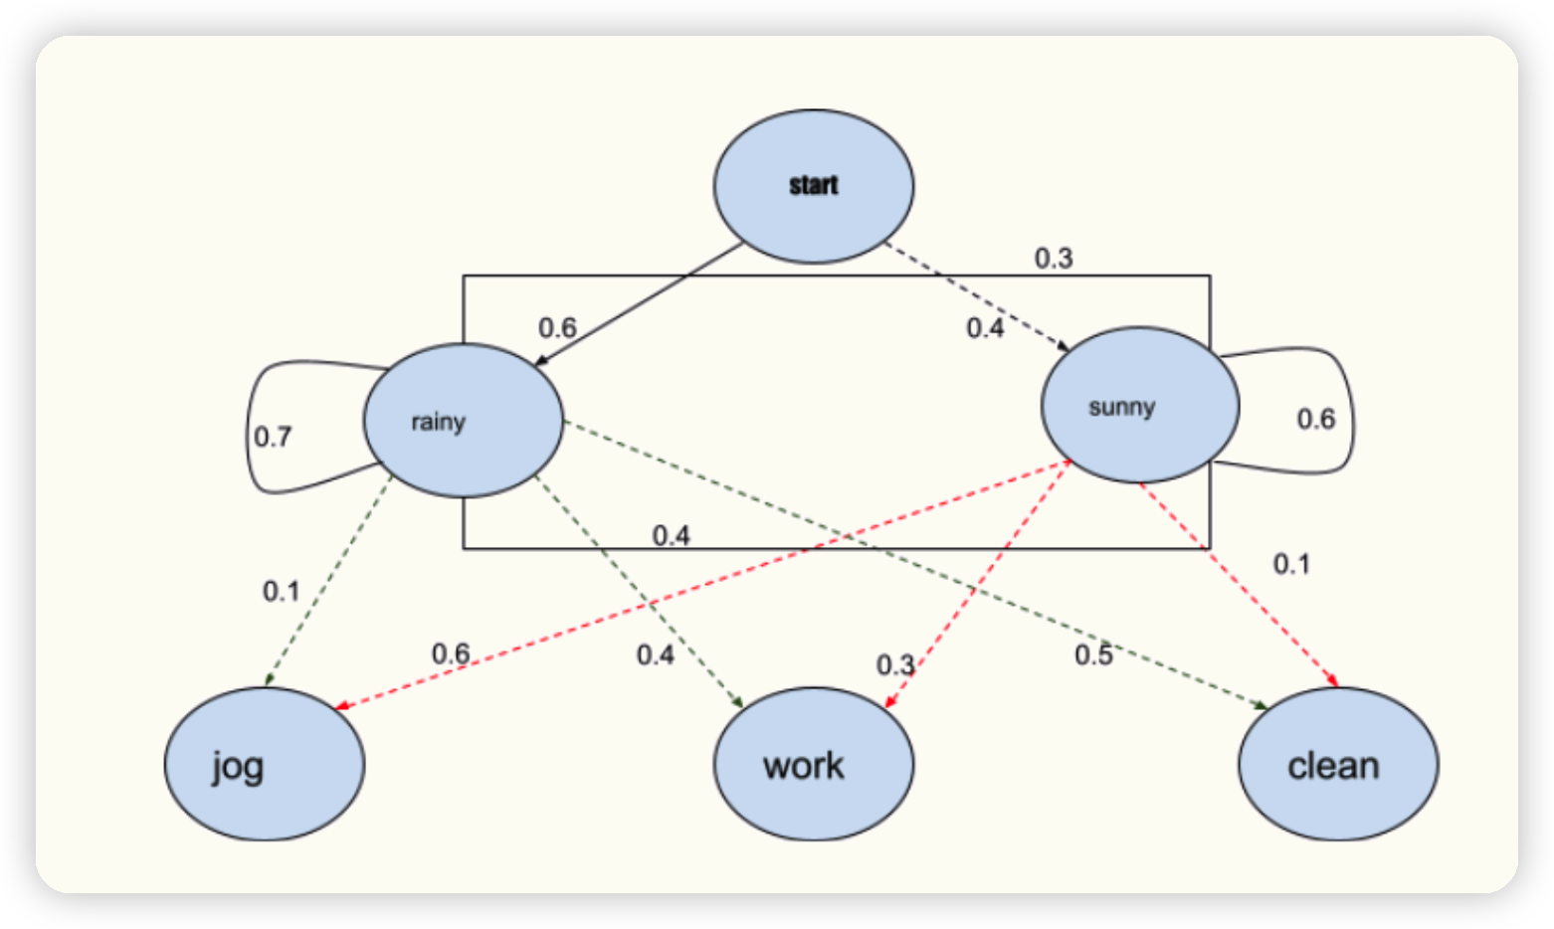
Hidden Markov Models
Simple HMM Example Illustrating the Relationship between Weather Conditions and Daily Activities

Slide 11
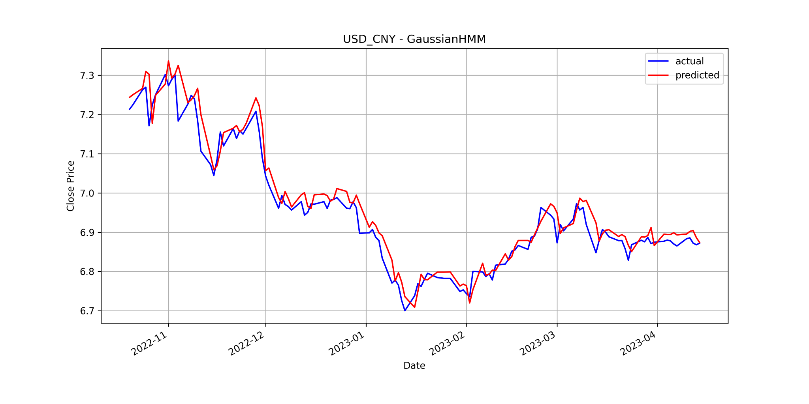
Hidden Markov Models
Strong fit between predicted and actual closing prices
Latent states capture underlying structure of time series data
Relationships between past and future price changes
Feature extraction: fraction change, fraction high, and fraction low
HMM-based approach demonstrates potential for Forex trend prediction (USD_CNY)
Further work: refine model, incorporate additional information
Compare HMM with other models, such as LSTM, to identify the most effective approach
MAE
RMSE
R2MAE
RMSE
R2
0.0255
0.0351
0.9471
0.0255
0.0351
0.9471
MAE | RMSE | R2
0.0255 | 0.0351 | 0.9471

Slide 12
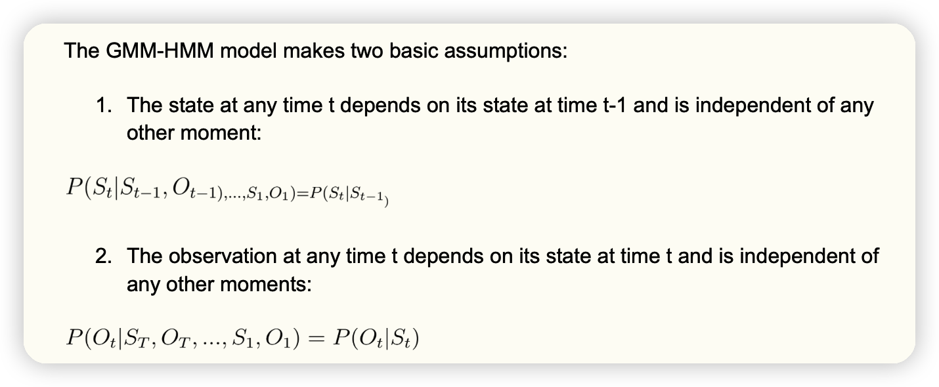
Gaussian Mixture Model-Hidden Markov Models
GMM-HMM
Applications: automatic speech recognition (ASR) and others
Basic Assumptions
State dependence on the previous state
Observation dependence on the current state

Slide 13
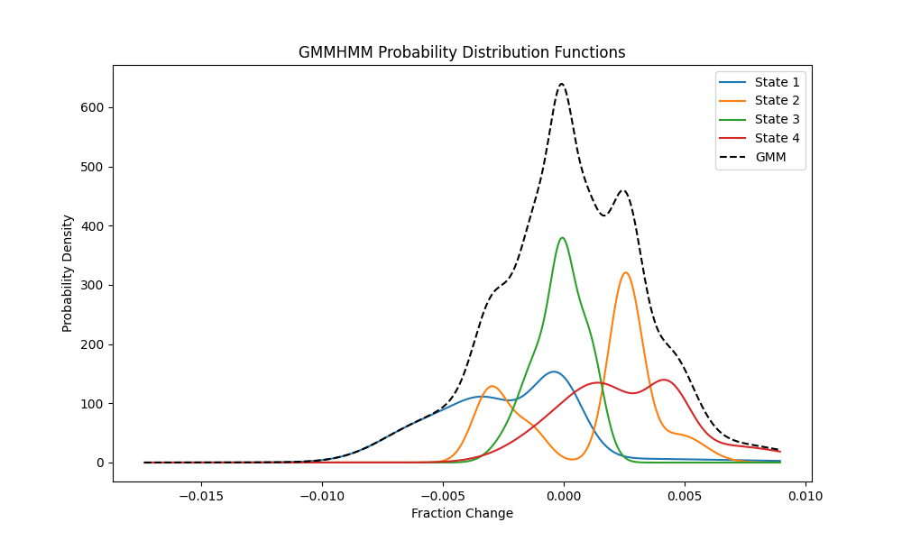
Gaussian Mixture Model-Hidden Markov Models
By leveraging the GMM-HMM framework, complex relationships between observable variables and hidden factors can be modeled effectively, making it a suitable choice for various applications, including Forex trend prediction.

Slide 14

Gaussian Mixture Model-Hidden Markov Models
Comparison to HMM model: Higher MAE and RMSE, lower R2
Slightly worse performance in predicting closing prices
Improvements and Future Directions
Tuning hyperparameters for better performance
Grid search results: Gaussian HMM - n_hidden_states: 6, n_latency_days: 12 (MAE 0.0228)
GMM-HMM - n_hidden_states: 5, n_latency_days: 14 (MAE 0.0402)
Addressing overfitting or underfitting with regularization or feature engineering
Exploring alternative models: LSTMs, GRUs, reinforcement learning, ensemble methods
Incorporating more features: technical indicators, trading volumes, macroeconomic data
Employing techniques to reduce overfitting risk: cross-validation, regularization
MAE | RMSE | R2
0.0467 | 0.0549 | 0.8706

Slide 15
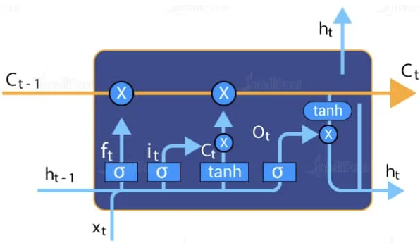
LSTM Model
The theoretical basis
LSTM networks use a set of specialized units called memory cells that can store information over long periods of time and selectively forget or remember information based on a gating mechanism. The gating mechanism controls the flow of information through the network, allowing it to selectively remember or forget information from previous time steps.
In an LSTM (Long Short-Term Memory) model, the cell state C and hidden state h are two important internal states in an LSTM network. The cell state is responsible for storing the long-term memory of the network, while the hidden state represents the network's output at a given time step.

Slide 16
LSTM Model
LSTM Model Definition
Input layer, two LSTM layers, and a fully connected output layer
Training the model using backpropagation and Adam optimizer
Minimizing mean squared error (MSE)
Training and Evaluation
Training loss visualization using Seaborn
Predicting future Forex prices on testing dataset
Evaluating predictions using root mean squared error (RMSE) metric

Slide 17
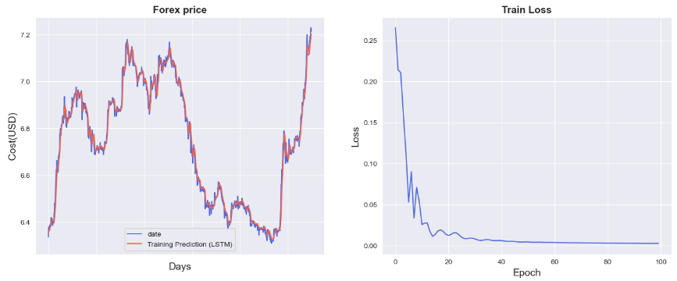
LSTM Model
The training loss and Train Forex price predictions made by the LSTM model. The loss function decreases as the number of epochs increase, which is expected in a well-performing LSTM model. The final loss value is relatively low, indicating a good fit of the model to the data.

Slide 18
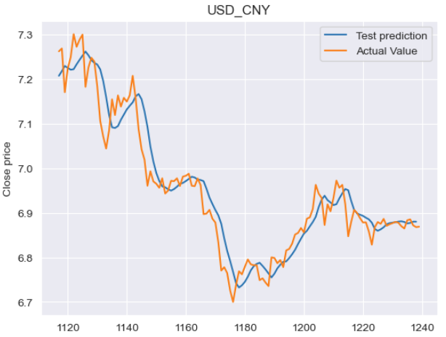
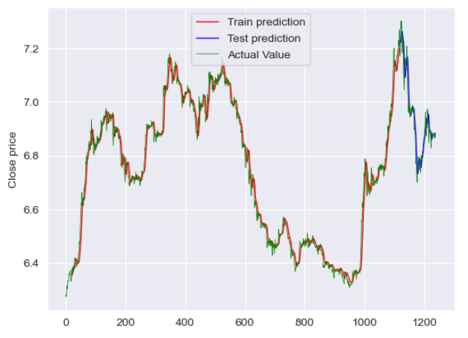
LSTM Model
The predictions are visualized using Matplotlib and Plotly, with separate plots for the training and testing datasets.

Slide 19
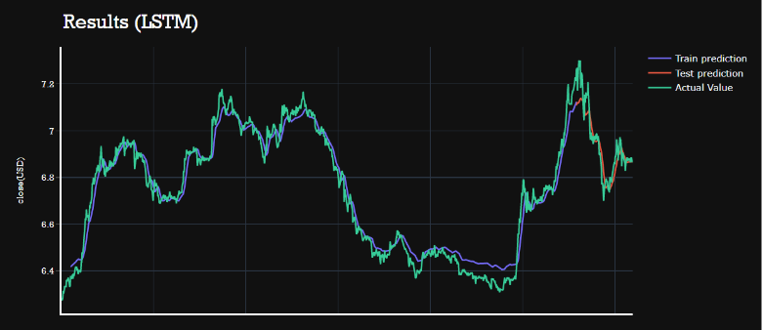

LSTM Model Result & Analysis
RMSE: My model's RMSE is 0.06, R2 = 0.0508, and MAE = 0.34. These values indicate that my model is performing reasonably well in predicting.
Plot: The plot shows that the actual prices closely follow the predicted prices, especially during the training period. During the test period, the actual prices show more variation than the predicted prices, but the overall trend is captured reasonably well by the model.
Overfitting: Based on the results I provided, there are no signs of overfitting in my LSTM model. The model appears to generalize well to the test set, as evidenced by the relatively low test RMSE.
In conclusion, my LSTM model appears to be performing reasonably well in predicting forex prices, with low RMSE values and a good fit to the data.

Slide 20
XGBoost
Boosting
Ensemble learning technique
Combining weak learners into a strong learner
Main idea
Gradient Boosting
XGBoost
Optimized implementation of gradient boosting
Parallelization, automatic handling of missing values, and built-in cross-validation

Slide 21
XGBoost
XGBoost Algorithm Flow
Start with a simple base model (usually a decision tree) that provides an initial prediction.
For each iteration:
Calculate the gradient of the loss function
Fit a new decision tree to the calculated gradient values
Add the new tree to the ensemble, applying a learning rate
Combine all the decision trees in the ensemble to make the final prediction

Slide 22
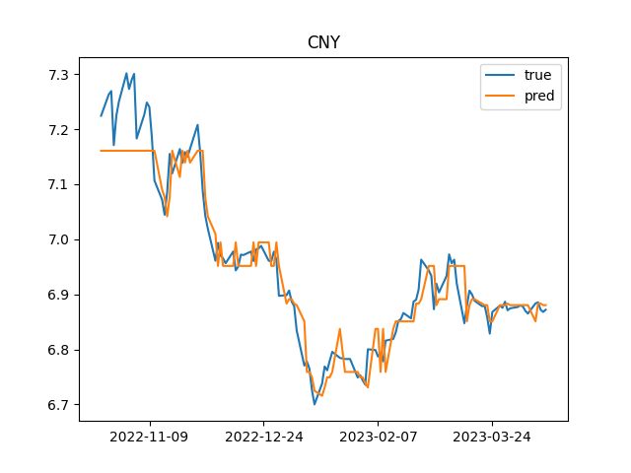
XGBoost
1st experiment:
MAE | RMSE | R2
0.03 | 0.0442 | 0.9148

Slide 23
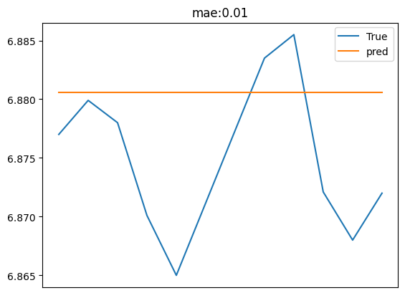
XGBoost
2nd experiment
MAE | RMSE | R2
0.01 | 0.0084 | -0.7311

Slide 24
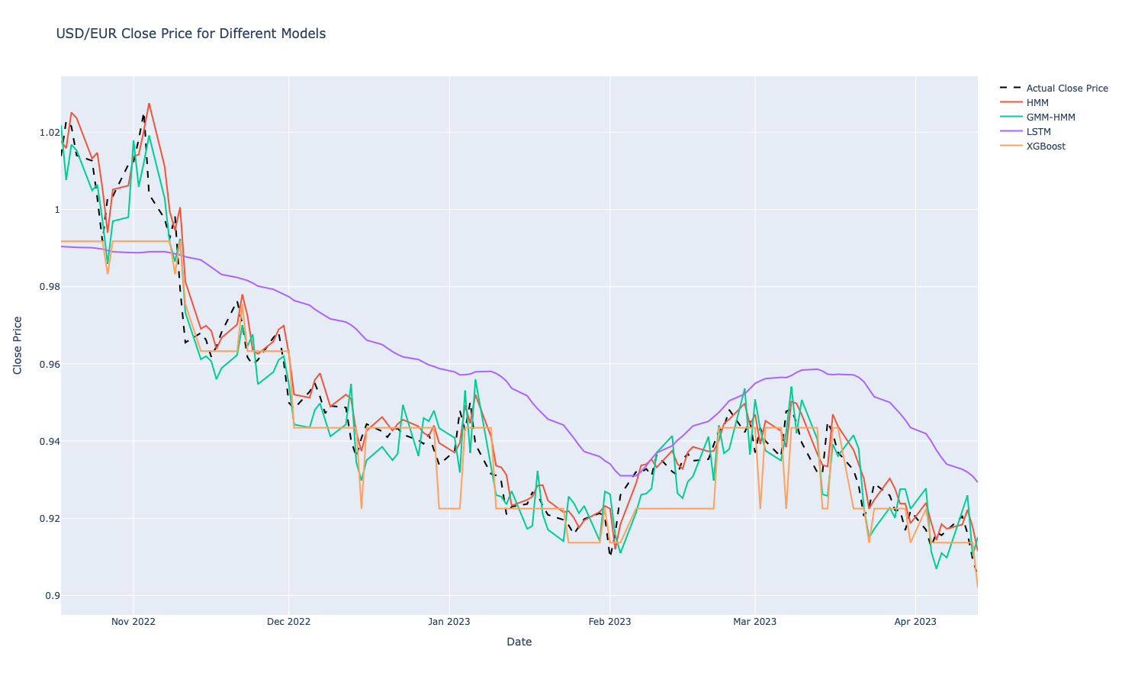
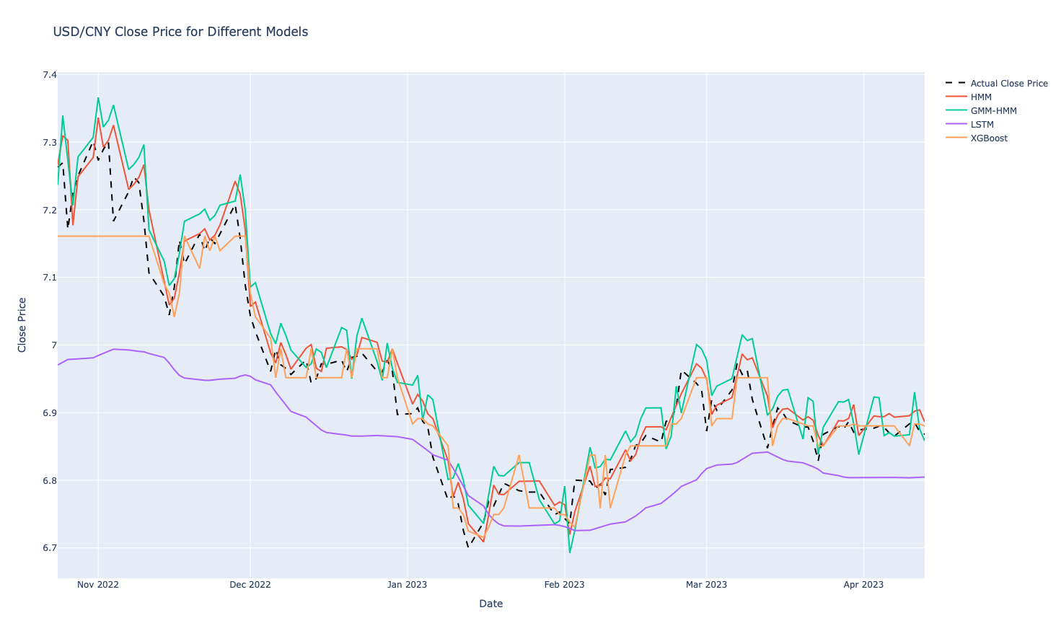
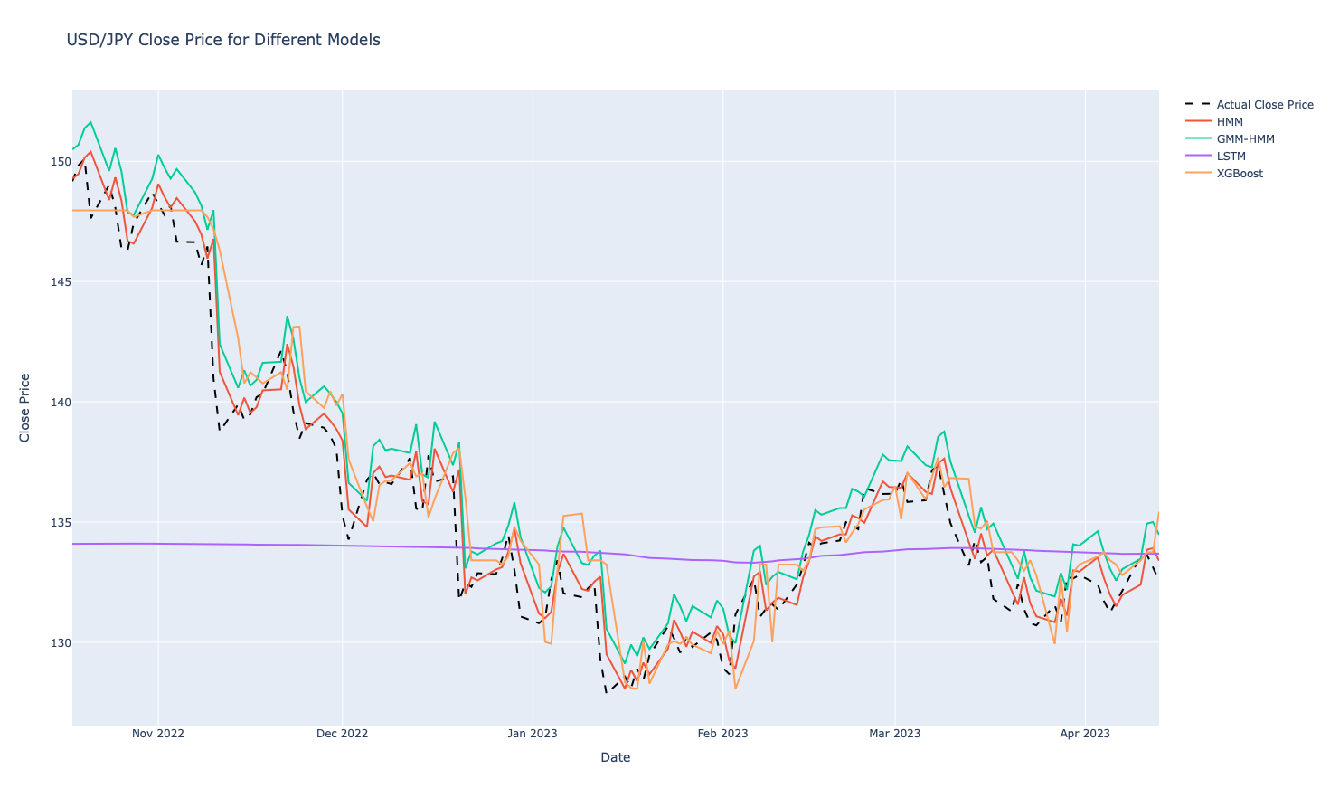
Performance Comparison

Slide 25
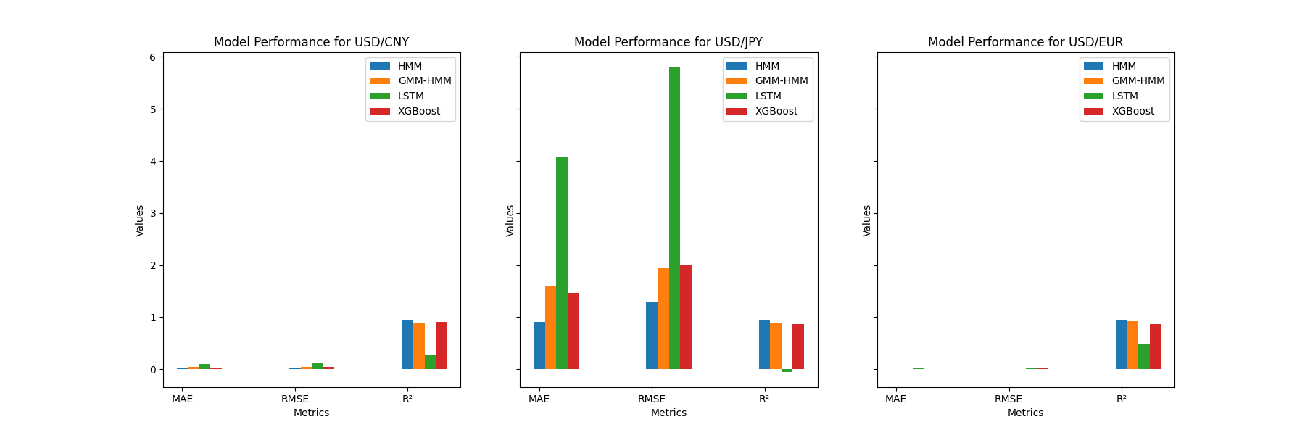
Performance Comparison
Our analysis reveals that the HMM model consistently performs well across all currency pairs, with lower MAE and RMSE values and higher R-squared scores. In contrast, LSTM exhibits the worst performance among the four models, with higher MAE and RMSE values and lower R-squared scores.

Slide 26
Performance Comparison
Several factors could contribute to the worst performance of LSTM among the 4 models.
Hyperparameter tuning
Model architecture
Feature engineering
Data preprocessing

Slide 27
Conclusion and Future work
HMM emerges as the most effective method for predicting the close price of the tested currency pairs.
GMM-HMM and XGBoost show comparable performance, both outperforming LSTM and sometimes performing better or worse than each other.
Although LSTMs are popular in time series forecasting, they may not be the best option for this particular problem.
The approach we took in this project was successful for the HMM model, as it consistently produced accurate predictions with low error rates. However, there is room for improvement, particularly for LSTM, GMM-HMM, and XGBoost models.

Slide 28
Conclusion and Future work
To enhance the performance of the models, we can consider the following strategies:
Further tuning of hyperparameters and model architectures, especially for GMM-HMM, LSTM, and XGBoost.
Incorporating additional features, such as technical indicators, to help the models capture more information about the market dynamics.
Ensembling multiple models or using a combination of different models to achieve more robust and accurate predictions.

